Slide 1
Chapter XI
Euler Transforms and Quaternions

Slide 2
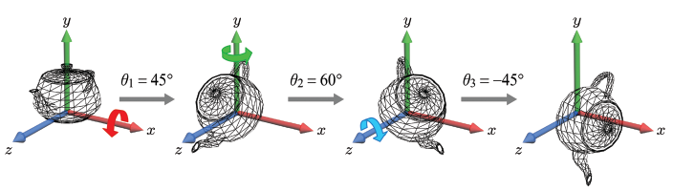
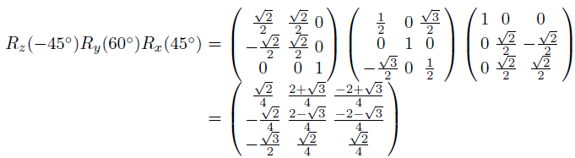
Euler Transforms
When we successively rotate an object about the principal axes, the object acquires an arbitrary orientation. This method of determining an object’s orientation is called Euler transform, and the rotations angles, (θ₁,θ₂,θ₃), are called the Euler angles.
Concatenating the rotation matrices produces a single matrix.
11-<number>

Slide 3
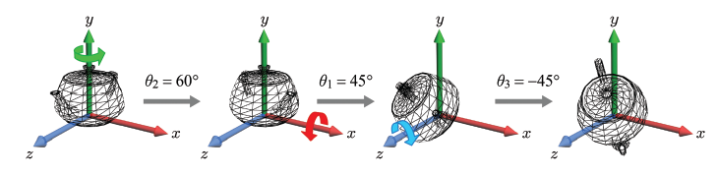
Euler Transforms (cont’d)
The rotation axes are not necessarily taken in the order of x, y, and z. Shown below is the order of y, x, and z. Observe that the teapot has a different orientation from the previous one.
11-<number>

Slide 4


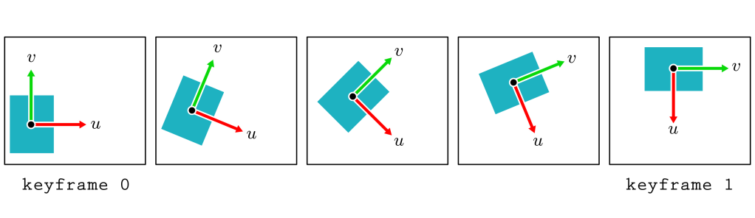
Keyframe Animation in 2D
In the traditional hand-drawn cartoon animation,
  the senior key artist would draw the keyframes, and
  the junior artist would fill the in-between frames.
For a 30-fps computer animation, for example, much fewer than 30 frames are defined per second. They are the keyframes. In real-time computer animation, the in-between frames are automatically filled at run time.
The key data are assigned to the keyframes, and they are interpolated to generate the in-between frames. Any data that change in the time domain can be interpolated,
In the example, the center p and orientation angle θ are interpolated.
11-<number>

Slide 5
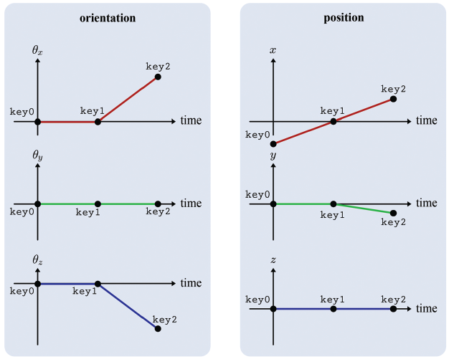
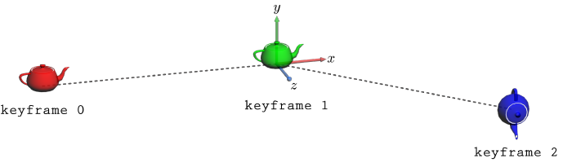
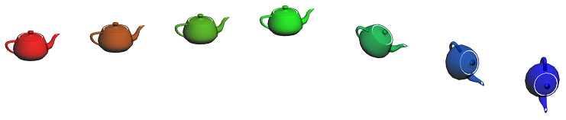
Keyframe Animation in 3D
Keyframe animation in 3D: Seven teapot instances are defined by sampling the graphs seven times.
11-<number>

Slide 6
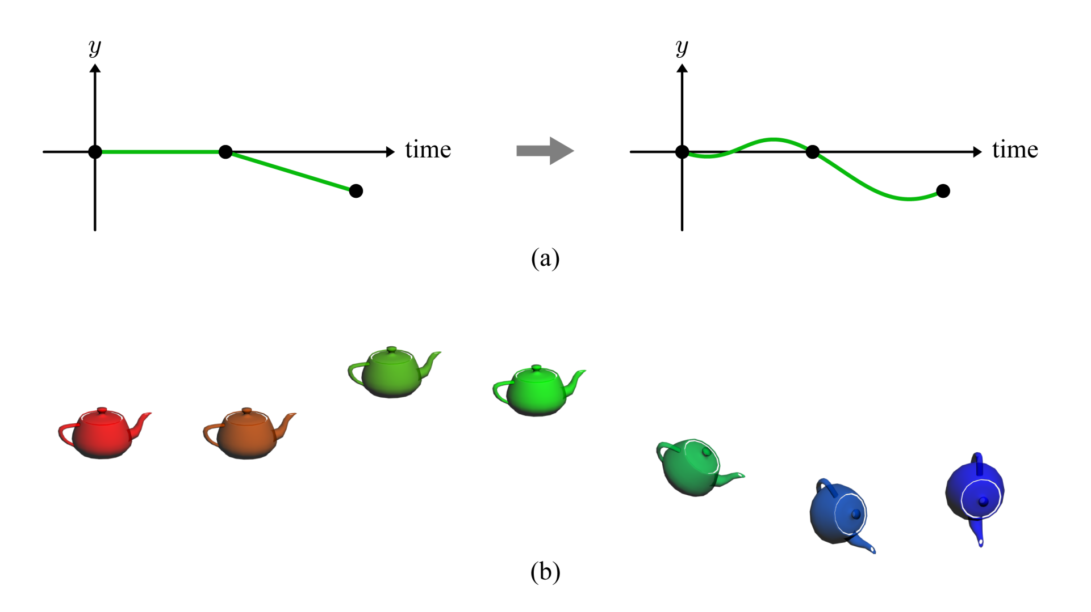
Keyframe Animation in 3D (cont’d)
Smoother animation may often be obtained using a higher-order interpolation.
11-<number>

Slide 7
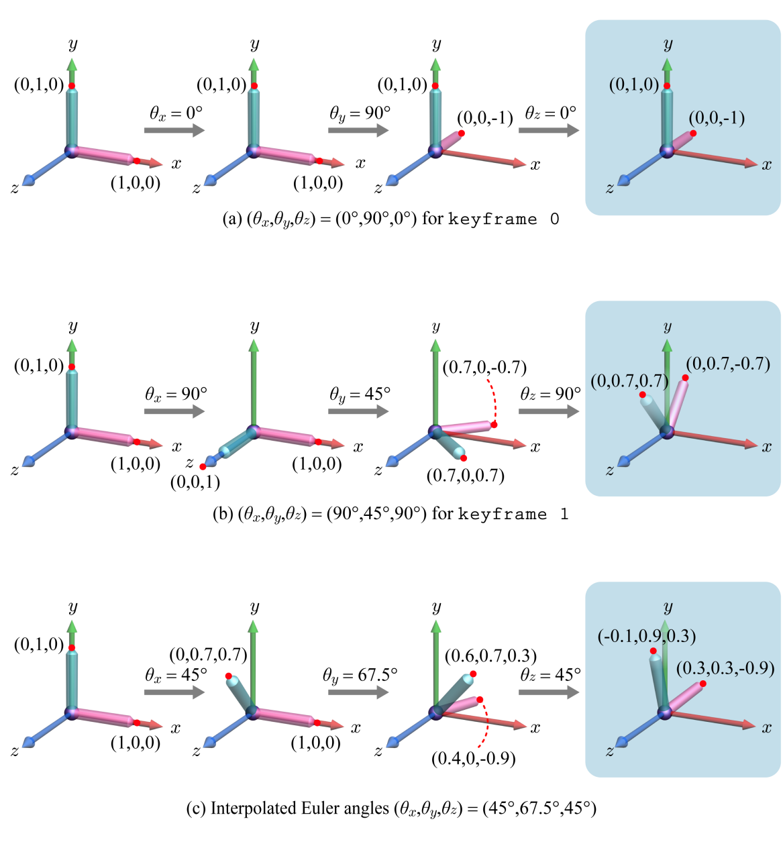
A Problem of Euler Angles
Euler angles are not always correctly interpolated and so are not suitable for keyframe animation.
11-<number>

Slide 8


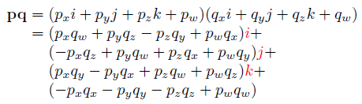


Quaternion
A quaternion is an extended complex number.
Conjugate
Magnitude (If the magnitude of a quaternion is 1, it’s called a unit quaternion.)
11-<number>

Slide 9

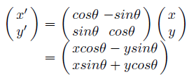

2D Rotation through Quaternion
Recall 2D rotation
Let us represent (x,y) by a complex number x+yi, and denote it by p.
Given the rotation angle θ, let us consider a unit-length complex number, cosθ+sinθi. We denote it by q. Then, we have the following:
Surprisingly, the real and imaginary parts of pq represent the rotated coordinates.
11-<number>

Slide 10

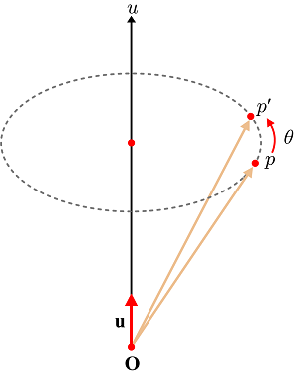


3D Rotation through Quaternion
As extended complex numbers, quaternions can be used to describe 3D rotation.
Consider rotating a 3D vector p about an axis u by an angle θ. Both “the vector to be rotated” and “the rotation” are represented in quaternions.
  Vector p to a quaternion p
  The rotation axis u and rotation angle θ
  define another quaternion q. (The axis
  u is divided by its length to make a
  unit vector u.)
  Then, the rotated vector is equivalent to
  the imaginary part of .
11-<number>

Slide 11
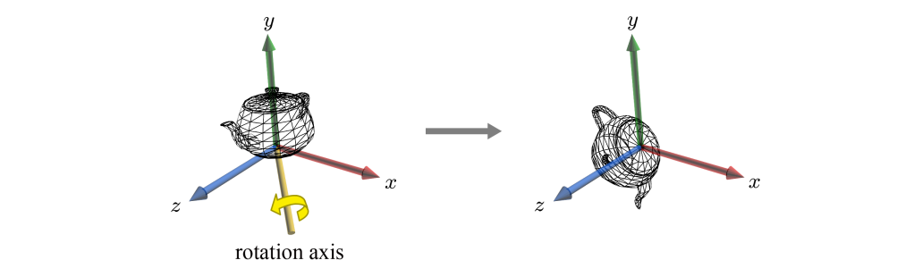

3D Rotation through Quaternion (cont’d)
Rotation about an arbitrary axis.
11-<number>

Slide 12

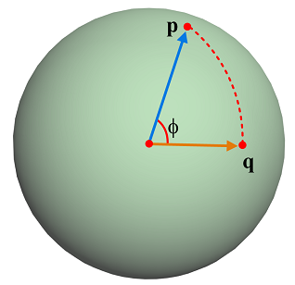
Interpolation of Quaternions
Consider two unit quaternions, p and q, which represent rotations. They can be interpolated using parameter t in the range of [0,1]:
This is called spherical linear interpolation (slerp).
11-<number>

Slide 13
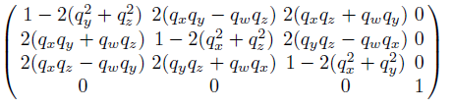
Quaternion and Matrix
A quaternion q representing a rotation can be converted into a matrix form. If q = (q_{x},q_{y},q_{z},q_{w}), the rotation matrix is defined as follows:
11-<number>

Slide 14
Quaternion and Matrix
Conversely, given a rotation matrix, we can compute the corresponding quaternion.
Its proof requires to extract {q_{x},q_{y},q_{z},q_{w}} from the following matrix:
  Compute the sum of all diagonal elements.
  So, we obtain q_{w}.
  Subtract m₁₂ from m₂₁ of the above matrix.
  As we know q_{w}, we can compute q_{z}. Similarly, we can compute q_{x} and q_{y}.
11-<number>

Slide 15
Quaternion - Summary
Summary
  An arbitrary 3D rotation is represented in a quaternion, as well as in Euler transform.
  Quaternions are well interpolated through spherical linear interpolation.
  A quaternion can be converted into a rotation matrix.
If quaternions are defined for the keyframes,
  they are spherically interpolated for the in-between frames, and
  they rotate the vectors through qpq*.
If Euler angles are defined for the keyframes,
  the Euler angles for each keyframe determine a matrix,
  the matrix is converted into a quaternion,
  The quaternions are spherically interpolated for the in-between frames, and
  they rotate the vectors through qpq*.
.
11-<number>

